Slide 1

Potential challenges in Non Terrestrial Networks
Arashmid Akhavain
Huawei Technologies Canada
IETF 121 – Dublin
November 2024

Slide 2






Interworking networks in 6G

Slide 3
NTN - Background and Motivations
Unfavourable geographical and economical obstacles
Gaps in broadband and wireless service deployment and coverage.
Significant advances in satellite-related technologies have made the possibility of deploying mega constellations of satellites economically feasible
Reduced equipment and production cost.
Reusable launch vehicles has lowered orbit placement cost.
Advancements in ION and E propulsion systems can extend service life for LEOs.
Improvements in ground-to-satellite and satellite-to-satellite interfaces
Progress in free-space optical (FSO) interfaces and ATP (Acquisition, Tracking and Pointing) systems are making it possible to use FSO interfaces as Inter-Satellite-Links (ISL).
Unique service offering for LEO satellite constellations
LEO networks can offer long-distance, low-latency services.

Slide 4
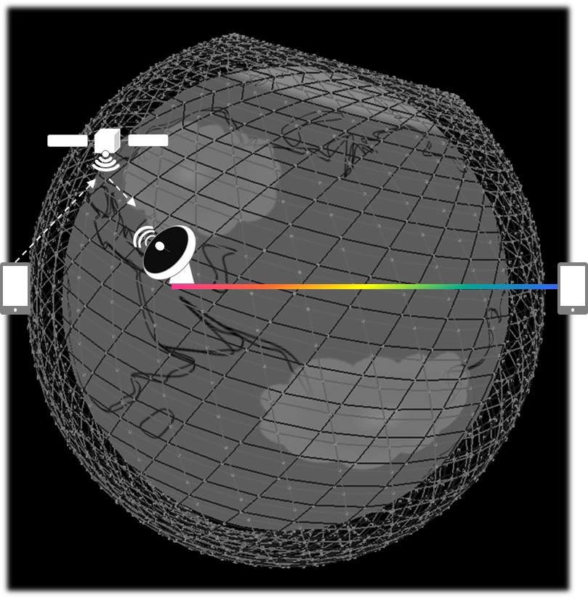
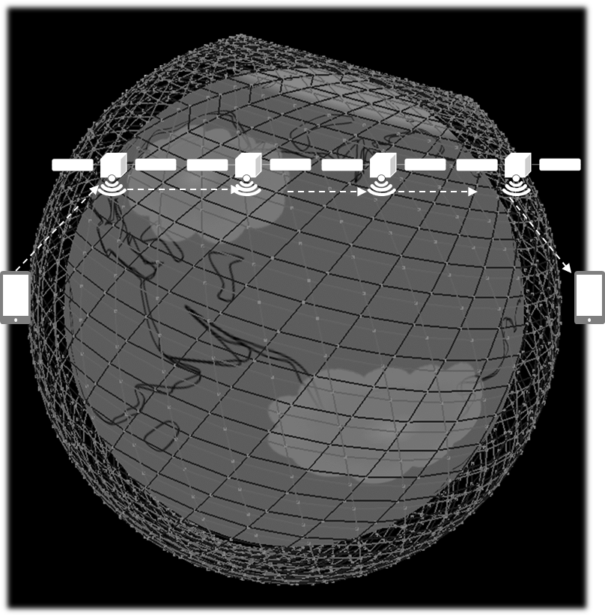
Different deployment models, different set of challenges
Constellation size.
Use of FSO or reverse bent pipes as ISL in satellite networks and impact of each approach on routing.
Handing over the traffic to terrestrial networks at the first available opportunity
Suitable for delay tolerant traffic.
Covers remote areas within reasonable vicinity to terrestrial networks.
Traditional bent pipe model where each satellite is guaranteed to have a GW in its line-of-sight.
Multi hop through number of satellites where each satellite can reach a GW via other satellites within its radius.
Moderate to heavy use of ISLs (FSOs or reverse bent pipe).
End to end traffic handling via satellite networks
Suitable for delay sensitive traffic (e.g. financial transactions).
Heavy dependency on ISLs (FSOs).
Potentially requires new approaches to traditional networking methods such as addressing, routing, forwarding, etc.

Slide 5
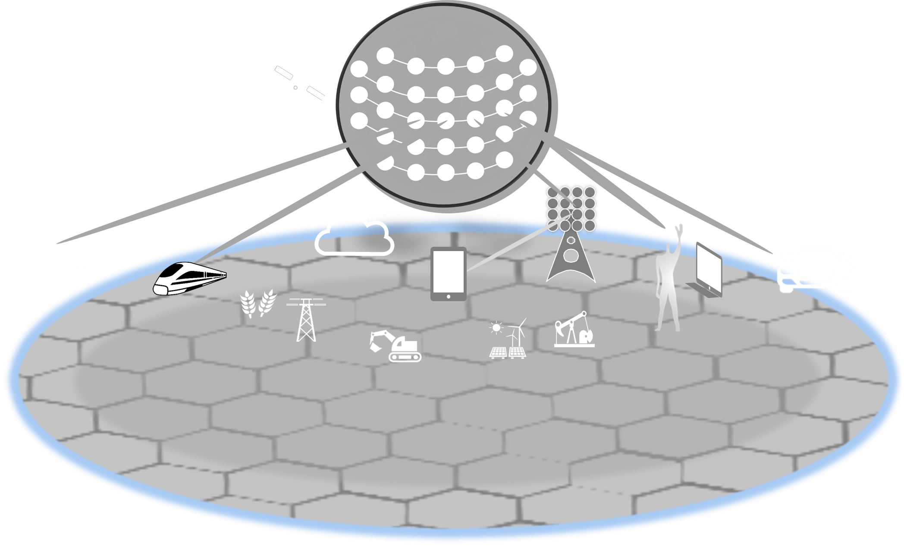
Ecosystem evolution???
Multi-vendor, multi-operator (Not supported by existing eco system)
Opens the market, encourages competition.
Provides service providers and enterprises with the type of flexibility that is offered by terrestrial networks today.
Interworking NFs can be placed in different satellites from different satellite operators.
Ground station, GWs, and satellites can belong to different entities.
Satellite network operators can provide support to different terrestrial operators, enterprises, etc.
Prevents customised per operator APIs and interfaces.

Slide 6
Networking Issues （1）
Addressing, Routing, and Forwarding are fundamentals of networking.
Network must provide support for scheduled, massive link fluctuations/events and peer adjacency changes.
Seam and polar areas in polar constellations.
Walker Delta constellation consisting of LEOs with 5+ links.
Network must support and safeguard against unpredictable link events.
Services carried over NTN are expected to be IP in nature.
Existing IP based networks are hierarchical.
IP does not lend itself well to nonhierarchical, massive scale networks of thousands of routers and millions of addresses.
IP employs address aggregation and topology abstraction to handle large scale networks.
Address aggregation: Achieved through wildcarding and best prefix match.
Topology abstraction: Achieved via the use of gateways.
Employ gateways and hide topologies behind them.
Route traffic to the gateways where more granular topologies are available for finer routing.
State of the art IP IGPs such as OSPF and ISIS can handle hundreds of routers and hundreds of thousands of addresses.
IP does not provide native support for mobility.
Additional protocols such as VxLAN are devised to support mobility in IP networks.

Slide 7
Networking Issues （2）
Traditional large scale networking
Aggregation and abstraction are crucial to scaling the network
Traditional link state protocols employ address abstraction & region definition to support hierarchy for network scalability.
Configuration and network engineering is essential.
Area IDs or region definition, interface addresses, etc. are configured attributes.
Peer adjacencies, regions, and topologies are established based on the above configured attributes.
Changing configuration attributes results in outage and floods to all other nodes in the area.
NTN factors
Satellites move w.r.t each other and the earth.
Earth rotates under the constellations.
Satellites move and swap peers at the poles.
Satellites change peers at the seam.
All orbits in Walker Delta with 5+ links per satellite exhibit the seam effect
Network service orchestration
Integrated/converged TN-NTN consists of nodes with different capabilities (e.g. storage, compute etc.). Resource orchestration and configuration is an essential requirement in service provisioning and delivery.

Slide 8
Networking Issues（3）
Traditional IP mechanisms should be examined in order to ensure that they work and perform well in LEO networks
Satellites’ movement breaks configurable hierarchal membership mechanisms in traditional networking.
The notion of proximity that wraps around the earth is absent in IP and cannot be handled by IP longest prefix match.
IP is NOT designed to handle frequent link events and changes in the network.
Aggregation, topology and address abstraction are key features for handling large scale networks.
Nodes’ movement is an obstacle in employing traditional configuration based hierarchy.
Satellite networks form a special Manhattan grid and are “FLAT” (i.e. They have no natural hierarchy and are wrapped on the surface of a sphere.)
Exploring alternative mechanisms to support the hyper dynamic nature of NTN can prove useful.

Slide 9
Potential area of work
Use of existing IP addressing and routing mechanisms.
Centralised route computation and configuration.
Use of multiple end-to-end tunnels for traffic forwarding.
Direct UE to satellite scenarios might involve some challenges here.
Uplinks and downlinks between single device and multiple satellites and their impact on the routing system. (i.e., Routing in the last mile).
Use of Almanac based routing.
New addressing and routing mechanisms to address potential issues around aggregation and abstraction techniques required to handle large flat networks.
Traffic engineering (TE). TE and constraint-based routing in satellite networks can be complex. So, I suggest for having it as an optional item in the scope.

Slide 10
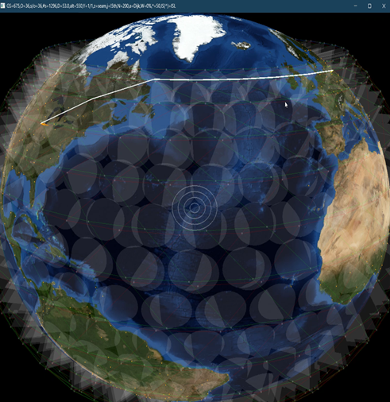
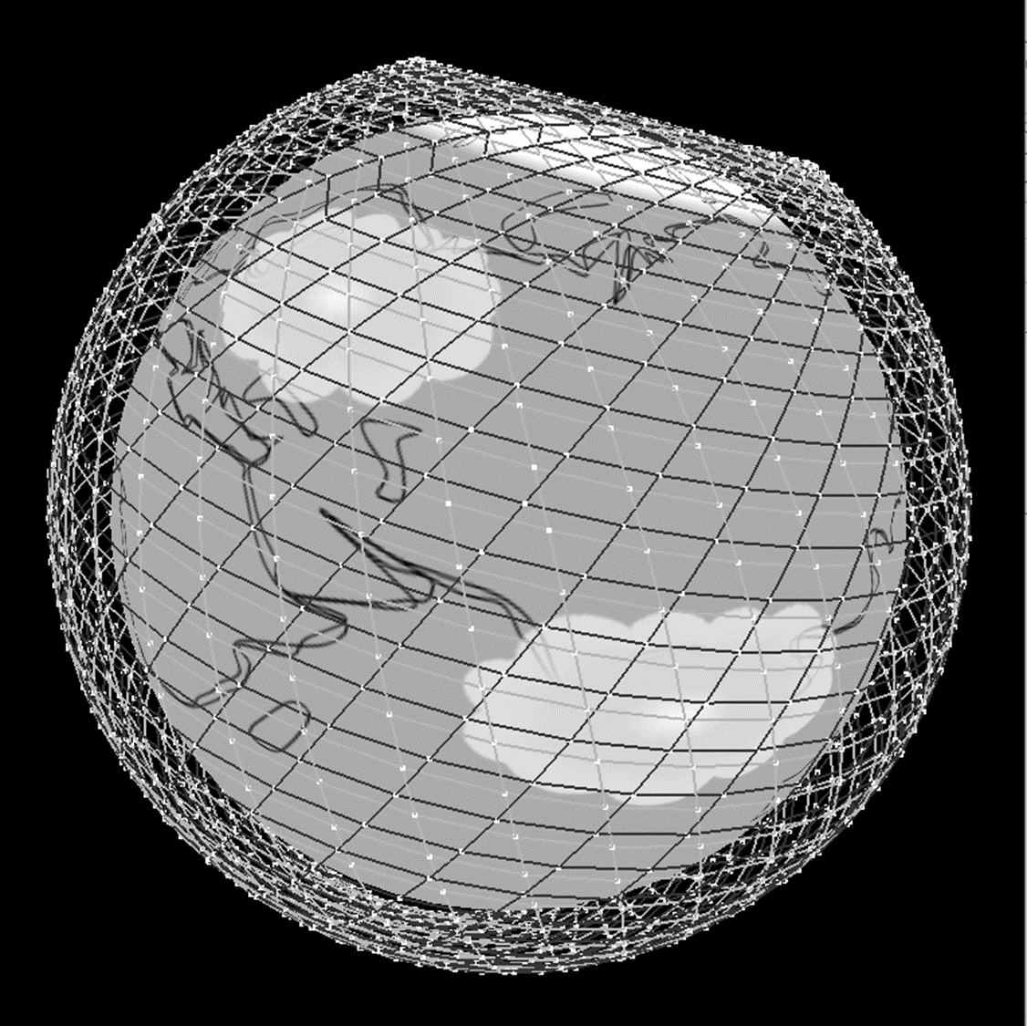

Coverage and connection stability
Support communications for any combination of
Inter satellite
Ground Station
Ground Terminals
User Terminals(i.e. UE)
Depending on constellation density, ground to ground connectivity and coverage might not be stable and may fluctuate periodically.
This may impact data or control plane
Ground-based gNB supporting users connecting over NTN network to a remote core.
Direct UE connection to satellite must be considered as well (not shown).
Support for multiple operators.
Delay variations resulting from node movements and path changes.
Potential impact on network protocols.
Traffic engineering and QoS
Nodes’ movement w.r.t earth along with periodic link fluctuations make resource allocation/reservation extremely challenging especially when taking nodes’ limited resources into account.
36x36 , 1296-node constellation at 550 km
N₃
N₂
N₁
6GC

Slide 11
Additional topics for consideration
Mobility faces new challenges
Earth rotates under network equipment
Network equipment and nodes move w.r.t each other.
Nodes can experience faster user mobility. (Fast moving terminal and UE (e.g. aircrafts).
Nodes can potentially experience more traffic variability compared to terrestrial nodes.
Hand-over between NTN and TN.
NTN configurations and architecture for mobile networks
NTN for backhaul
NTN and different fronthaul flavors potentially including
LEO as RRH (UE direct connectivity to satellites)
LEO as gNB
LEO as DU component of access.
HAPs over urban area
Handling much larger number of users in single gNB, RRH.
Power consumption aware routing and traffic delivery (Tidal networks)
Scheduled based networking
Advanced power management.
Possible temporary traffic reroute and ground transmission based on anticipated power levels (or other factors) between adjacent nodes.
Federated/collaborative up/down link attachments to ground stations (GS).
Scalability is a major factor which requires special attention at different levels of integrated TN-NTN
gNB
Mobile
network
gNB
Mobile
network
DU
CU
Mobile
network

Slide 12
Standardisation Aspects (1)
NTN’s impact on 6G standardisation is derived by applications and use case scenarios such as
Mobile services
Delay sensitive services
Cloud operators and bulk data transfer
Quantum key distribution
Transparent architecture where satellites act as relay nodes have been the primary mode of operations of satellite networks and the focus of standardization bodies so far.
Emergence of massive multi shell satellite networks with ISLs and compute is changing the above trend. Satellite networks are moving towards regenerative architecture.
Satellite technology and NTN related topics are scattered through standards development organizations.
Different SDOs have partial responsibilities when it comes to NTN.
Effective integration of satellite and terrestrial networks requires investigations and coordination of efforts among different SDOs.
A wide variety of topics could be addressed including, but not limited to:
Use cases
Architecture
Scalability
OAM and operational models
Multi service and multi tenancy
Networking, addressing, routing, and forwarding
Network service orchestration
QoS and traffic engineering
Coverage and connectivity
Mobility and power consumption aware traffic delivery
High Altitude Platform Stations (HAPS)
AI/ML for NTN, NTN for AI/ML
LEOs and NANO satellites as sensors.
Security and privacy

Slide 13
Standardisation Aspects (2)
Some satellite or NTN related activities include:
Definition of broadband over GEO
General satellite network issues (e.g. DVB ecosystem)
Specific satellite (non-network) issues (e.g. Regulatory)
Some network aspects are not new, but must now be examined in view of
New dynamics and scale of LEO networks
New services may now require remote access (e.g. IOT)
New platforms (e.g. HAPS)
Standardisation efforts are in their initial stages
Some mobile operators and equipment manufacturers in partnership with satellite operators are starting to support basic services via proprietary solutions.
Location services
Emergency SOS
Short, predefined text messages

